Slide 1
London, 9-10th May 2022
Socio-economic inequalities in care use and caregiving
across European long-term care systems

Slide 2
Long-term care (LTC)
Long-term care: help to meet the needs of older people with a chronic illness or disability, provided by:
Family members, friends etc. at home → informal care
Professional providers (public, volunteers or paid-for) at home → formal home-care
Professional providers in nursing homes → institutional care
Ginevra Floridi

Slide 3
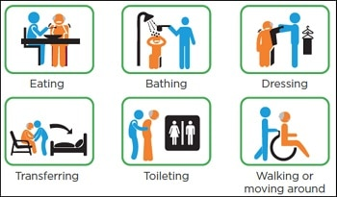
Long-term care (LTC)
Long-term care: help to meet the needs of older people with a chronic illness or disability, provided by:
Family members, friends etc. at home → informal care
Professional providers (public, volunteers or paid-for) at home → formal home-care
Professional providers in nursing homes → institutional care
Personal care only, as opposed to help with
household chores or paperwork.
Ginevra Floridi

Slide 4
Research questions
How do socio-economic differences in formal and informal LTC use relate to LTC system characteristics?
How do LTC system characteristics relate to the socio-economic distribution of informal / formal care (accounting for health disparities by SES)?
Do SES gradients in care use change in response to LTC system restructuring (re-familisation of care)?
Are there socio-economic differences in the provision of informal care?
How does informal caregiving vary with country-level characteristics?
Ginevra Floridi

Slide 5
SES inequalities in care use and caregiving
Different dimensions of SES: wealth, income, educational attainment
SES inequalities in formal / informal care use
Matter for inequalities in older adults’ health and well-being (more on this tomorrow)
SES inequalities in informal caregiving
Matter for inequalities in caregivers’ health and well-being (more tomorrow)
Matter for the SES distribution of employment opportunities
Ginevra Floridi

Slide 6
Inequalities in care and LTC system characteristics
Are some LTC systems more/less conducive to SES (in)equality in care use/caregiving?
IN-CARE: focus on “familism” vs. “de-familisation” in LTC
Familism = extent to which family (as opposed to the state) is considered responsible for care to older adults (Saraceno, 2016).
Ginevra Floridi

Slide 7
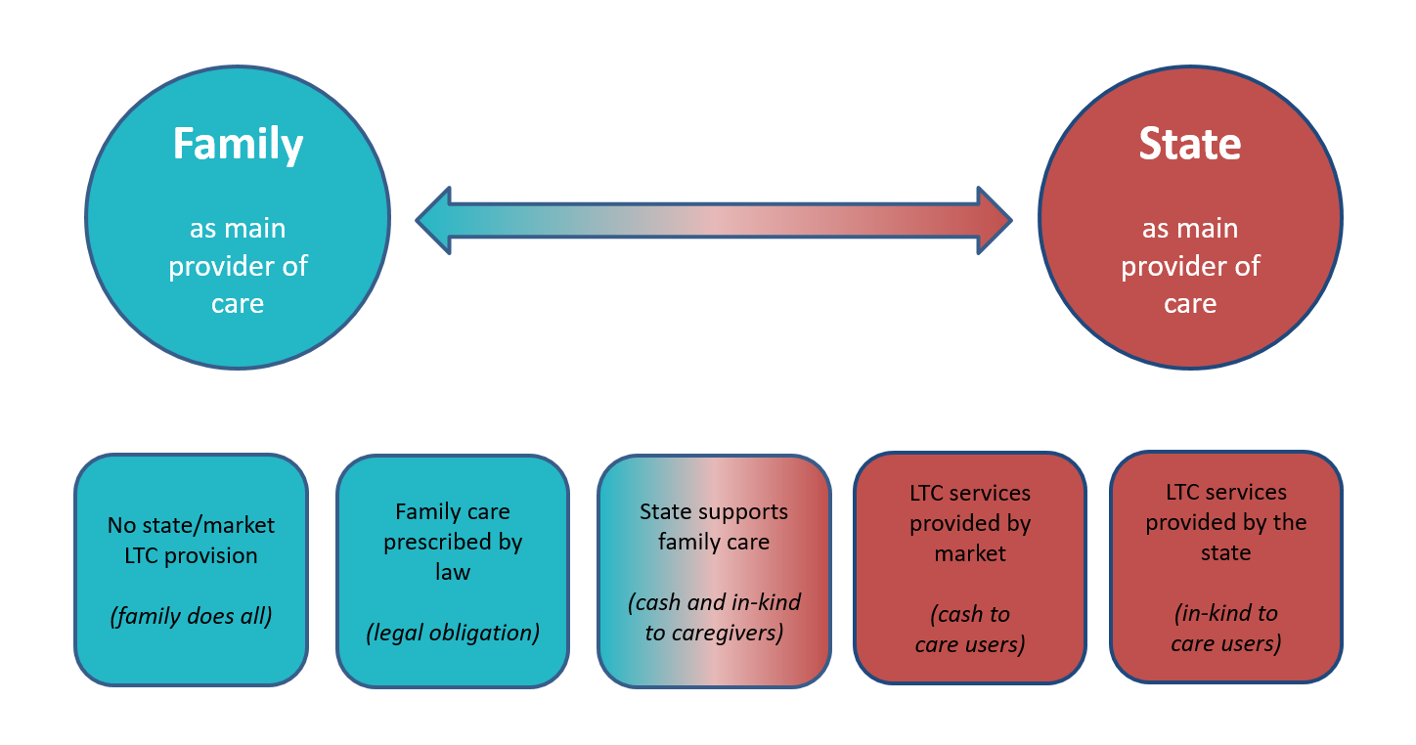
Familism vs. de-familisation in LTC
Ginevra Floridi

Slide 8
Project contribution and outline
Relate contextual LTC system characteristics...
LTC system generosity & alternatives to family care
Social care spending
1) To inequalities in formal and informal care use (WP2)
  Across European administrative regions
  Across English councils
2) To inequalities in informal caregiving (WP3)
  Across European countries
3) To inequalities in formal and informal care use (WP4)
  Across different LTC contexts in the Netherlands
Ginevra Floridi

Slide 9
WP2: Socio-economic inequalities in care use
Ginevra Floridi | Ludovico Carrino | Karen Glaser
Ludovico Carrino | Ginevra Floridi | Mauricio Avendano | Karen Glaser
Ginevra Floridi

Slide 10
Background
Are higher-SES individuals more likely to use formal care than lower-SES individuals?
“Pro-rich inequality” in formal care
  Albertini & Pavolini (2017): yes (Italy, Germany); no (Denmark, the Netherlands)
  Carrieri et al. (2017): yes (Southern & Continental Europe); no (Northern Europe)
  Rodrigues et al., (2018): no (14 European countries), but depends on SES indicator (income vs. wealth)
Are lower-SES individuals more likely to use informal care than higher-SES individuals?
“Pro-poor inequality” in informal care
  Broese van Groenou et al. (2006): yes (Belgium, Italy, the Netherlands, UK)
  Motel-Klingebiel & Tesch-Roemer (2005): no (England, Germany, Norway, Spain)
Ginevra Floridi

Slide 11
Contribution
Previous studies only refer to large clusters or entire countries so cannot disentangle LTC policies from other factors
Floridi, Carrino, & Glaser (2021):
Study wealth and income gradients in informal, formal and mixed- care across 136 administrative regions in 12 European countries
Link individual data on care use and SES with LTC policy indicator
  LTC system variation within and across countries
Ginevra Floridi

Slide 12
SES inequalities in LTC in Europe
Individual data: Survey of Health, Ageing & Retirement in Europe (2015)
15,407 individuals 65+ with at least one disability (ADL / IADL / mobility)
136 administrative regions (NUTS-2)
12 European countries (AT, BE, CH, CZ, DE, EE, ES, FR, HR, IT, PO, SE)
Information on care receipt, SES, and predisposing/need factors
Ginevra Floridi

Slide 13
SES inequalities in LTC in Europe
Individual data: Survey of Health, Ageing & Retirement in Europe (2015)
15,407 individuals 65+ with at least one disability (ADL / IADL / mobility)
136 administrative regions (NUTS-2)
12 European countries (AT, BE, CH, CZ, DE, EE, ES, FR, HR, IT, PO, SE)
Information on care receipt, SES, and predisposing/need factors
Regional-level data: Eurostat (2015)
LTC beds = number of beds in residential care facilities / 1000 pop.
Indicator of de-familisation (through state or market)
Strongly positively correlated with public spending on residential (~0.8) and home-based (~0.6) formal care
Ginevra Floridi

Slide 14
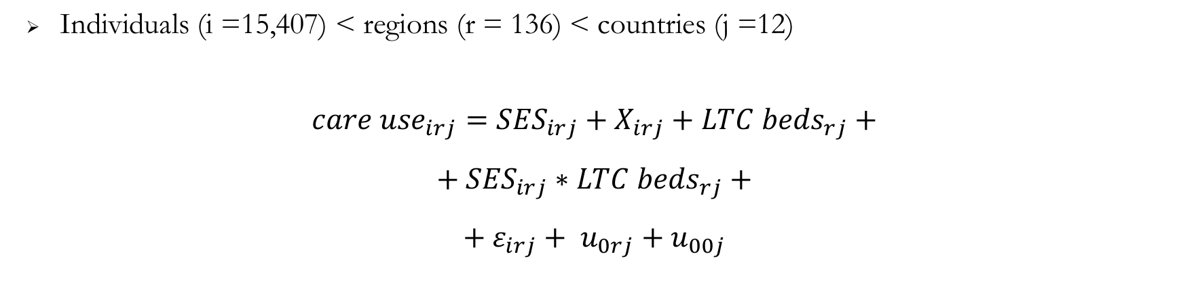
SES inequalities in LTC in Europe
Multinomial multilevel model
M1: region- and country- random intercepts
M2: region random intercepts, country fixed-effects, reg. controls for GDP and pop 65
Ginevra Floridi

Slide 15
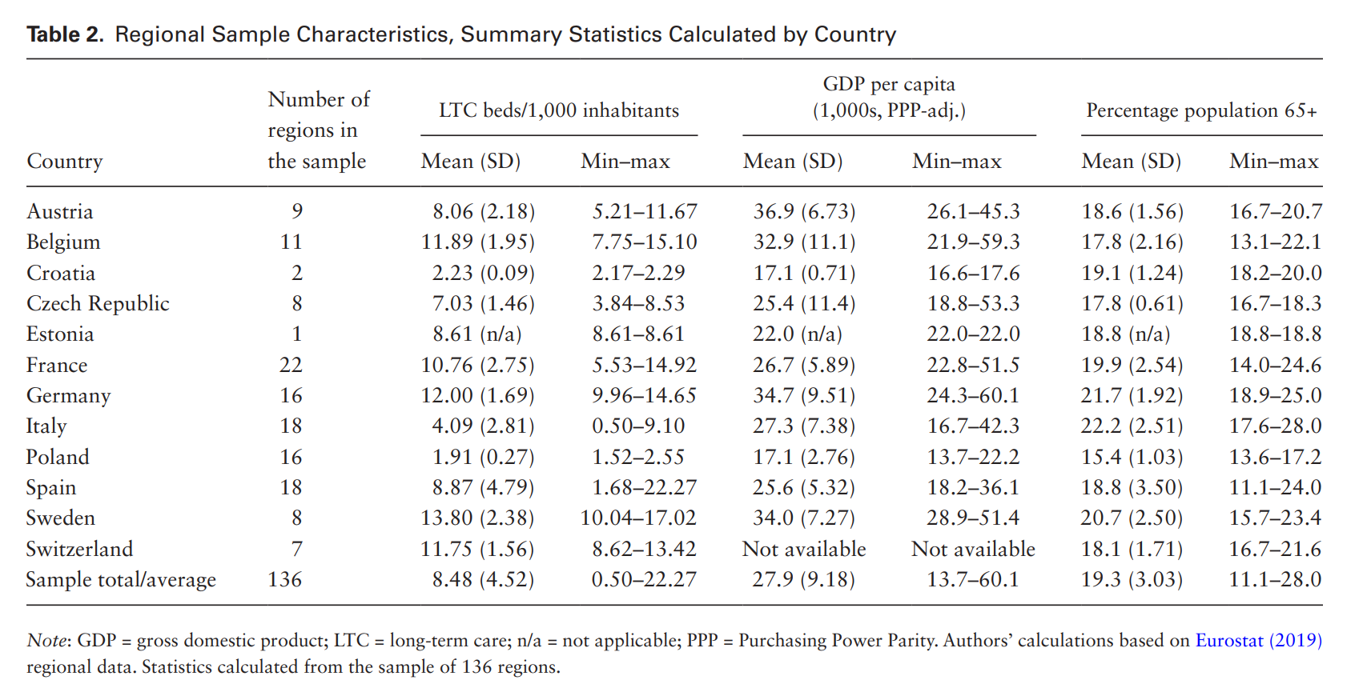
SES inequalities in LTC in Europe
Ginevra Floridi

Slide 16
SES inequalities in LTC in Europe
Ginevra Floridi

Slide 17
SES inequalities in LTC in Europe
Ginevra Floridi

Slide 18
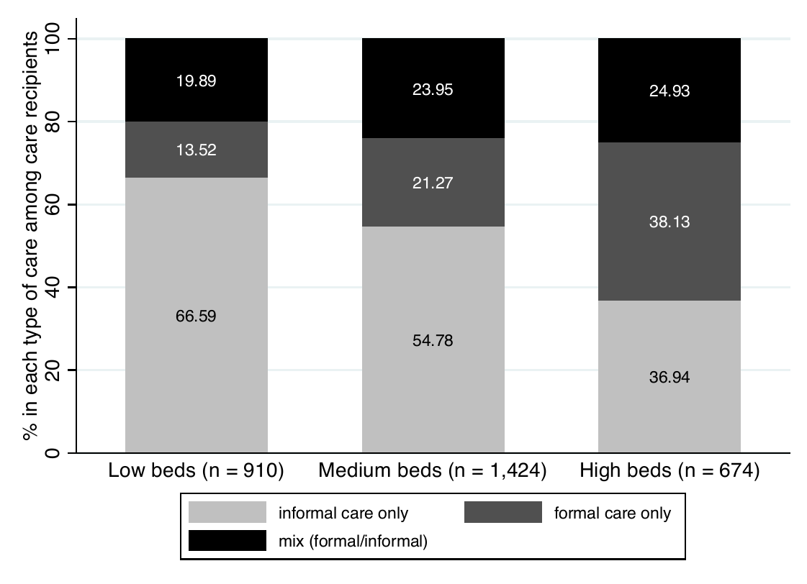
SES inequalities in LTC in Europe
Ginevra Floridi

Slide 19
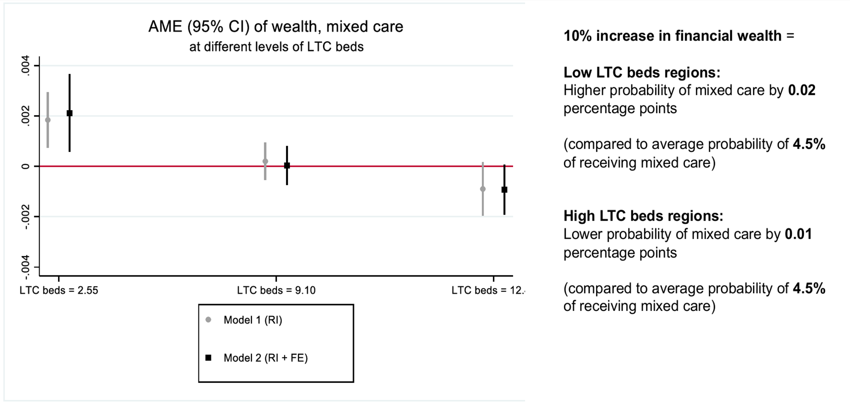
Multivariate results
Ginevra Floridi

Slide 20
SES inequalities in LTC in Europe
Limitations
Cross-section of regions (no institutional change over time)
LTC beds indicator not really what we are interested in
  Proxy, but not a measure for public provision – includes both state and market
  Measures provision of institutional (not home-based) care
Ginevra Floridi

Slide 21
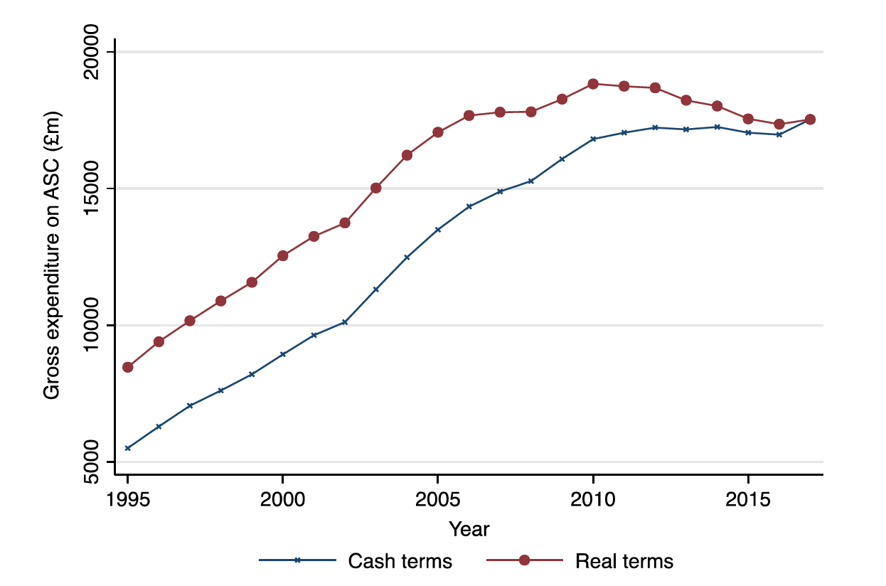
Budget cuts and LTC use in England
England
31% real-term reduction in per-capita LTC spending between 2009 and 2017 (Crawford et al., 2021)
Compare with previous long-term increase in gross expenditure - in line with increasing demand due to population ageing (Glasby et al., 2021)
Glasby et al., (2021) A lost decade? A renewed case for adult social care reform in England. Journal of Social Policy, 50: 406-437.
Ginevra Floridi

Slide 22
Budget cuts and LTC use in England
No evidence on changes in individual LTC use
(and potential inequalities)
Glasby et al., (2021) A lost decade? A renewed case for adult social care reform in England. Journal of Social Policy, 50: 406-437.
Ginevra Floridi

Slide 23
Budget cuts and LTC use in England
How does public expenditure on home-care relate to the use of formal home-care by disabled older individuals?
Ginevra Floridi

Slide 24
The English LTC context
Two key features of the English social care system:
Budget cuts (2010-present)
Means testing with complex national-level rules determining eligibility to receive publicly-funded care (“financial assessment”)
year | Lower threshold (£) | Upper threshold (£)
2002/03 | 11,750 | 19,000
2004/05 | 12,250 | 20,000
2006/07 | 12,750 | 21,000
2008/09 | 13,500 | 22,250
2010/11 | 14,250 | 23,250
2012/13 | 14,250 | 23,250
2014/15 | 14,250 | 23,250
2016/17 | 14,250 | 23,250
2018/19 | 14,250 | 23,250
Eligible to receive care if:
Below lower capital (wealth) threshold, OR
Below upper capital (wealth) threshold & below “Minimum Income Guarantee” after the cost of care is deducted
  £189/week (single)
  £144/week (member of couple)
Ginevra Floridi

Slide 25
Budget cuts and LTC use in England
Two sources of data:
Individual-level data from the English Longitudinal Study of Ageing (ELSA)
  9,341 individuals aged 65+ between 2002 and 2019 (9 waves) → n = 28,336
  Information about:
    Care use (formal home-care)
    Individual eligibility for public LTC (based on detailed assets and income data)
Ginevra Floridi

Slide 26
Budget cuts and LTC use in England
Two sources of data:
Individual-level data from the English Longitudinal Study of Ageing (ELSA)
  9,341 individuals aged 65+ between 2002 and 2019 (9 waves) → n = 28,336
  Information about:
    Care use (formal home-care)
    Individual eligibility for public LTC (based on detailed assets and income data)
Expenditure on home-based formal care by local authority from the UK government
  Data on 149 local authorities between 2004-2018 (15 years)
  Indicator harmonisation across local authorities and years
  Adjusted for CPI and only referring to expenditure on adults 65+
Ginevra Floridi

Slide 27
Budget cuts and LTC use in England
Ginevra Floridi

Slide 28
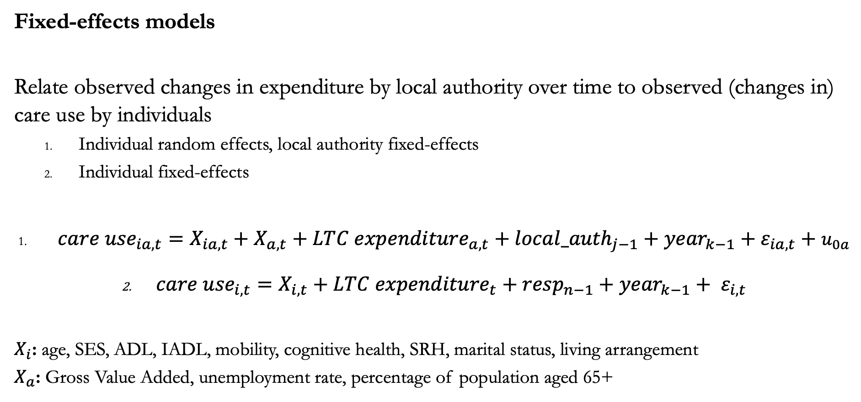
Budget cuts and LTC use in England
Fixed-effects models
Relate observed changes in expenditure by local authority over time to observed (changes in) care use by individuals
  Individual random effects, local authority fixed-effects
  Individual fixed-effects
${care use}_{ia,t}=X_{ia,t}+X_{a,t}+{LTC expenditure}_{a,t}+{local_auth}_{j−1}+{year}_{k−1}{+ ε}_{ia,t}+ u_{0a}$
${care use}_{i,t}=X_{i,t}+{LTC expenditure}_{t}+{resp}_{n−1}+{year}_{k−1}+ ε_{i,t}$
$X_{i}$: age, SES, ADL, IADL, mobility, cognitive health, SRH, marital status, living arrangement
$X_{a}$: Gross Value Added, unemployment rate, percentage of population aged 65+
Ginevra Floridi

Slide 29
Budget cuts and LTC use in England
Locally-weighted regression of formal care on time, by eligibility status.
Eligibility defined as being eligible for social care (based on means-test and disability) in every year of the survey.
Ginevra Floridi

Slide 30
Multivariate results (1)
Formal home-care | Means-test eligible (all years) |  | Means-test ineligible (all years)
 | RE model | FE model | RE model | FE model
Log (expenditure) | 0.027 (0.012) * | 0.032 (0.014) * | 0.009 (0.007) | 0.014 (0.011)
Controls | yes | yes | yes | yes
LA fixed-effect | yes | n/a | yes | n/a
N (individuals) | 3,187 | 3,187 | 4,551 | 4,551
N (observations) | 8,600 | 8,600 | 14,210 | 14,210
Individual controls: age, capital (assets), income, ADL, IADL, mobility limitations, poor cognitive health, self-rated health, marital status, and number of individuals in the household. LA controls: Gross value added, unemployment rate, percentage of population aged 65+.
* indicates p<0.05
Ginevra Floridi

Slide 31
SES inequalities among the financially eligible?
Formal home-care | Coefficient | Standard error
Log(expenditure) | 0.031 ** | (0.012)
Zero-capital | 0.209 | (0.081)
Log(expenditure) * Zero-capital | -0.018 * | (0.007)
N = 8,600 (sample of 3,187 respondents fulfilling the means test criteria for public social care )
Individual controls: age, individual capital (assets), income, ADL, IADL, mobility limitations, poor cognitive health, self-rated health, marital status, and number of individuals in the household. LA controls: Gross value added, unemployment rate, percentage of population aged 65+.
** indicates p<0.01 ; * indicates p<0.05
Ginevra Floridi

Slide 32
Re-familisation of care and inequalities in care use
In summary
Across Europe, re-familisation of care may lead to inequalities in care use
In “familistic” regions, higher-SES more likely to receive mixed-care, lower-SES more likely to rely exclusively on informal care
When budget cuts hit in England, poorer groups decreased formal home-care use
  Increasing inequality in formal care (eligible = capital below ~£24k)
  Although the “poorest poor” may have been protected
Ginevra Floridi

Slide 33
WP3: Socio-economic inequalities in caregiving
Nekehia T. Quashie | Melanie Wagner | Ellen Verbakel | Christian Deindl
Ginevra Floridi

Slide 34
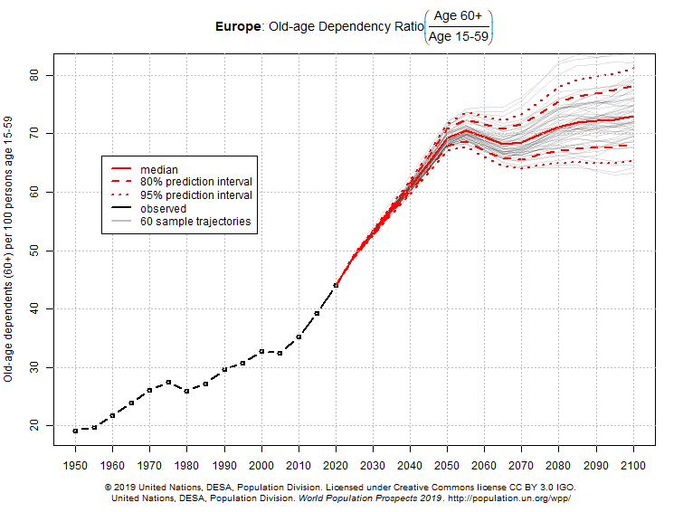
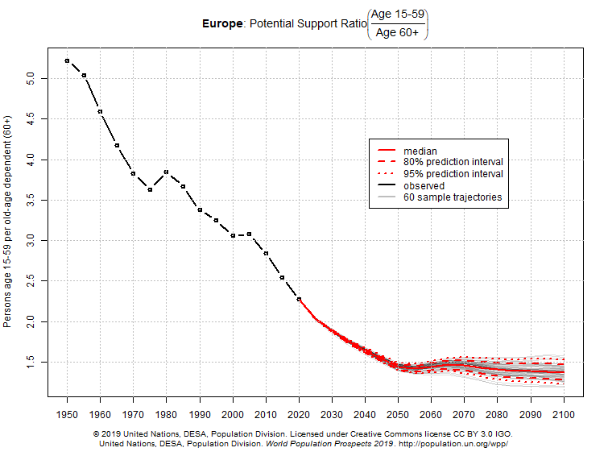
Ageing Europe
Ginevra Floridi

Slide 35
Background: informal caregiving in later life
Informal caregivers are primarily:
Women (Schmid et al., 2012)
Spouses, followed by adult children (Agree & Glaser, 2009)
Socio-economic inequalities
Informal care use more common among lower-SES (Broese van Groenou et al., 2006)
Country characteristics
Welfare state policies shape family caregiving (Brandt et al., 2009)
Social inequality associated with lower public and private transfers (Deindl & Brandt, 2019)
Ginevra Floridi

Slide 36
Contribution
Research focus so far
SES inequalities in care use (Broese van Groenou et al., 2006; Rodrigues et al., 2018)
Conflict with employment (Vlachantoni, 2010; Moussa, 2019)
We do not know
Whether informal caregiving falls disproportionately among lower-SES groups
Which aspects of SES (education, income, wealth) are linked with caregiving
Which aspects of country context (economy or welfare spending) shape caregiving
Ginevra Floridi

Slide 37
Research questions
Are there SES differences in the provision of informal care (by education, income, and wealth)?
  Expect lower-SES to be more likely to provide care
Can differences in the provision of informal care be explained by country differences in income inequality and social spending?
  Expect income inequality to be associated with lower care provision (lower solidarity among individuals)
  Expect higher social spending to be associated with lower family care (higher state responsibility for intensive care)
Ginevra Floridi

Slide 38
Data & method
SHARE waves 1, 2, 4, 5, 6 (2004-2015)
ELSA waves 2, 3, 4, 6, 7 (2004-2015)
Pooled dataset (first observation):
97,872 respondents aged 50+ not living alone or only with children aged <18
21 countries
Ginevra Floridi

Slide 39
Data & method
Outcome = provision of personal care within the household (yes/no)
Independent variables (SES):
Education (ISCED): low; medium; high
Household wealth (Euros): <0; 0-49,000; 50,000-99,999; 100,000+
Couple yearly income: poor (<50% median); low-medium (50%-median); middle (median-200%); high-medium (200-300%); high income (>300% of median)
Independent variables (country-level, averaged across years):
Income inequality: Gini coefficient of income inequality
Social spending: total social protection expenditure as % GDP (incl. support for sickness, disability, family old age, unemployment, housing)
Ginevra Floridi

Slide 40
Data & method
Statistical analysis: Multilevel Poisson regression models
Caregiving status regressed on individual SES and country-level characteristics
Controls for age, gender, household size, employment status, IADL limitations, and interview year.
Nested models
M1: country random intercept
M2: M1 + individual SES
M3: M2 + individual controls
M4: M3 + country-level Gini
M5: M3 + country-level social spending
Ginevra Floridi

Slide 41
Results
*p<0.05, **p<0.01, ***p<0.001
Ginevra Floridi

Slide 42
Results
Micro-level:
Lower SES associated with higher incidence of informal caregiving
Aligned with research on inequalities in care use (Floridi et al., 2021)
*p<0.05, **p<0.01, ***p<0.001
Ginevra Floridi

Slide 43
Results
Macro-level:
Income inequality associated with higher incidence of caregiving
Stronger reliance on close-knit networks in vulnerable circumstances
Larger share of population in poor health (Wilkinson & Pickett, 2009)
Social spending associated with lower incidence of caregiving
Specialisation of state-family for intensive caregiving (Brandt et al., 2009)
Potentially reflect preferences for non-family support for personal care (Mair et al., 2016)
*p<0.05, **p<0.01, ***p<0.001
Ginevra Floridi

Slide 44
Summary
Socio-economic inequalities across regional LTC systems in Europe (Floridi, Carrino, & Glaser, 2021)
Informal care more common among lower-SES groups
Formal care more common among higher-income groups
Mixed-care SES distribution varies with LTC beds availability (pro-rich in more “familistic”, pro-poor in more “de-familised” settings)
LTC expenditure cuts in England (Carrino, Floridi, Avendano, & Glaser)
LTC budget cuts related to lower use of formal home-care among lower-SES groups
Socioeconomic differences in informal caregiving in Europe (Quashie, Wagner, Verbakel & Deindl, 2021)
Lower SES related to higher provision of informal care in the household
Country-level income inequality related to higher provision of informal care
Country-level social spending related to lower provision of informal care
Ginevra Floridi

Slide 45
Dissemination
Socio-economic inequalities across regional LTC systems in Europe (Floridi, Carrino, & Glaser, 2021)
The Journals of Gerontology: Series B https://doi.org/10.1093/geronb/gbaa139
Gerontological Society of America (GSA) 2021
Nuffield College Sociology Seminar 2022
WP2 Stakeholder meeting 2020 (London)
LTC expenditure cuts in England (Carrino, Floridi, Avendano, & Glaser)
Population Association of America (PAA) 2022
ISA Research Committee on Social Stratification (RC28) 2022
European Consortium for Sociological Research (ECSR) 2022
Socioeconomic differences in informal caregiving in Europe (Quashie, Wagner, Verbakel & Deindl, 2021)
European Journal of Ageing https://doi.org/10.1007/s10433-021-00666-y
WP3 Stakeholder meeting 2020 (Dortmund)
Ginevra Floridi

Slide 46
WP4: Socio-economic inequalities in care use in the Netherlands
Jens Abbing | Bianca Suanet | Marjolein Broese van Groenou
Jens Abbing

Slide 47
Background
LTC in the Netherlands
  Traditionally high LTC expenditure
  Public provision of LTC resources (home and residential) generous.
  But: Repeated cost-containment measures
  De-institutionalization policies since the mid 2000s
  Decentralization of LTC responsibilities to municipalities
SES-inequality
Dependent on the source:
  Publicly provided and informal care use more prevalent in lower SES-groups
  Privately paid care use concentrated in higher SES-groups
Jens Abbing

Slide 48
Background
Rising SES-inequality?
  Complex LTC system, individual responsibility, obstacle for disadvantaged populations?
  Lower SES-groups are dependent on a more limited welfare state, forced to rely on family?
  But: Public LTC resources concentrated on lower SES-groups (Tenand & Bakx, 2015).
Research question
How and why did SES-inequalities in the use of
formal, informal and private care change among older adults in
the Netherlands between 1995,2005 and 2015?
Jens Abbing

Slide 49
Method
Sample
  3 measurements: 1995, 2005 en 2015
  1810 participants, 75-85, home-dwelling
  Cross-sectional
Analysis
  Logistic regression with LTC use as outcome
  Predictors: SES (education & Income) & Year
  Control: Age, Gender
  Mediators: Health (ADL, MMSE), Social network (Partner, Children)
Jens Abbing

Slide 50


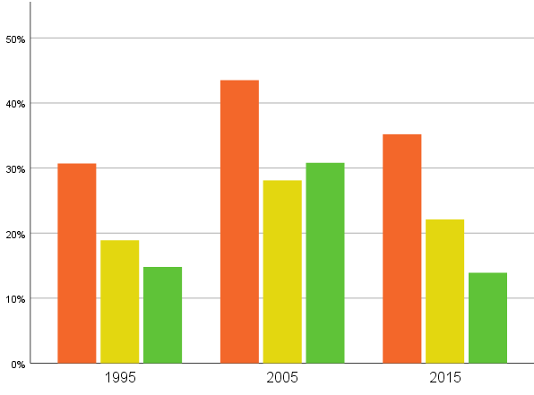
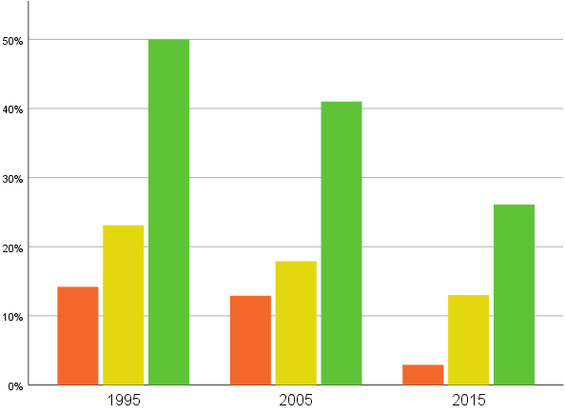
Results (1/2)
    Formal care use
    Privately paid care use
    Mostly used by low SES
    No significant change in inequality
    Mostly used by high SES
    No significant change in inequality
Jens Abbing

Slide 51

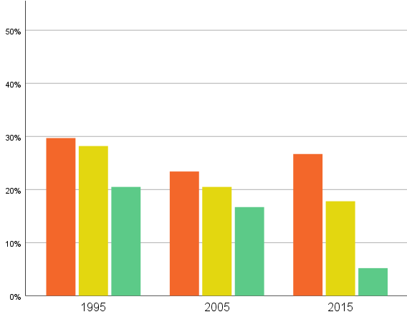
Results (2/2)
Conclusions (Abbing et al. 2021)
    Informal care use
    Inequalities mostly maintained, but decreasing informal care use by higher SES
    Interpretation:
    No shift towards more informal care use despite policy efforts
    Concerns that lower SES become more disadvantaged not confirmed
    Open questions:
    Decreases in LTC use due to changes in needs or provision?
    What are the consequences for wellbeing?
    Mostly used by low SES
    Significantly more inequality in 2015
Jens Abbing

Slide 52

Ginevra Floridi

