Slide 1
ORA IN-CARE project meeting
May 9-10, 2022
King’s College London UK

Slide 2
Introduction
Welcome
Hybrid modus
Objectives of the meeting
Answers to the RQs
Scientific impact – theoretical advancement
Societal impact – LTC policy instruments
Plans for the future
Set-up of the program
Materials: program, ppts and overview of papers

Slide 3
Main research model
WP1 – macro level data base
WP2 / WP4 / WP5: care use and wellbeing of CR
WP3 / WP5: care provision and wellbeing of CG

Slide 4
Strong features of IN-CARE
Socioeconomic inequality in care and wellbeing
Perspectives of CR and CG
Across nations and across time
Link between macro- and micro-level indicators
Distinction in (de)familization indicators

Slide 5
Theoretical advancement
Cross-national comparisons: SES-inequality in care use and care provision explained by individual level AND macro-level factors
Within country studies: SES-inequality in care use remained or even increased in different LTC contexts
Is distinction between familization and de-familization possible in empirical studies? Use of IN-CARE database
SES-inequality in care use does not add to SES-inequality in wellbeing – how is care related to wellbeing?
Need to combine the model of care use and the model of care provision?

Slide 6
Societal impact
What are general policy implications re familization and de-familization?
Which specific policy instruments increase or decrease SES-inequality in care use and provision, and wellbeing?
Do we need to distinguish between policy instruments for care users and care providers?
What messages do we want to convey to different type of stakeholders?

Slide 7
program
Monday afternoon:
SES-inequality in care use –
LTC Policies
Online present: Nekehia, Mauricio, Melanie, Rong Fu
Tuesday morning:
SES-inequality and wellbeing –
Future plans
Online present: Martin, Mauricio, Axel, Melanie, Rong Fu

Slide 8
Future plans: FAMCARE
Marjolein Broese v Groenou

Slide 9
Rationale
Increased need for informal care due to population ageing
Decreased potential of informal care due to demographic develoopments (ratio oldest old and younger generations) and decreased opportunities to provide informal care
Expected scarcity of informal care in the years to come
Main question of the grant proposal:
How informal care remains a sustainable part of LTC in the next decades while preserving the wellbeing of CR and ICGs

Slide 10
Proposed solution: FAMCARE
Families share the care with other informal caregivers (social network) and formal caregivers (publicly and privately paid) in a care network
Modeling how care use and care provision underlies the formation of care network
Modeling how care networks impact on wellbeing of CR, partners and adult children
Testing the models in cohort-sequential designs (LASA 1992-2022)
And in replicated multi-actor Family Caregiver Study (2001 versus 2023) of LASA respondents

Slide 11
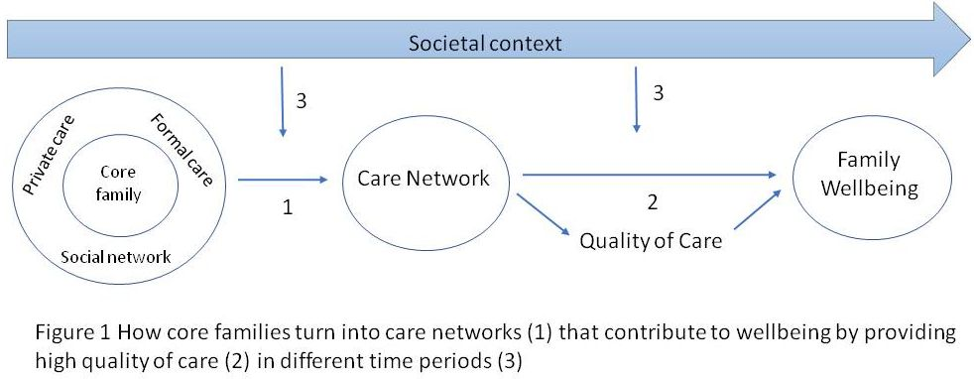
FAMCARE – RQs
Three years, two post-docs, one Academic Advisory Board and two societal partners
Grant proposal for the NWO Open Competition in the NL

